Slide 1


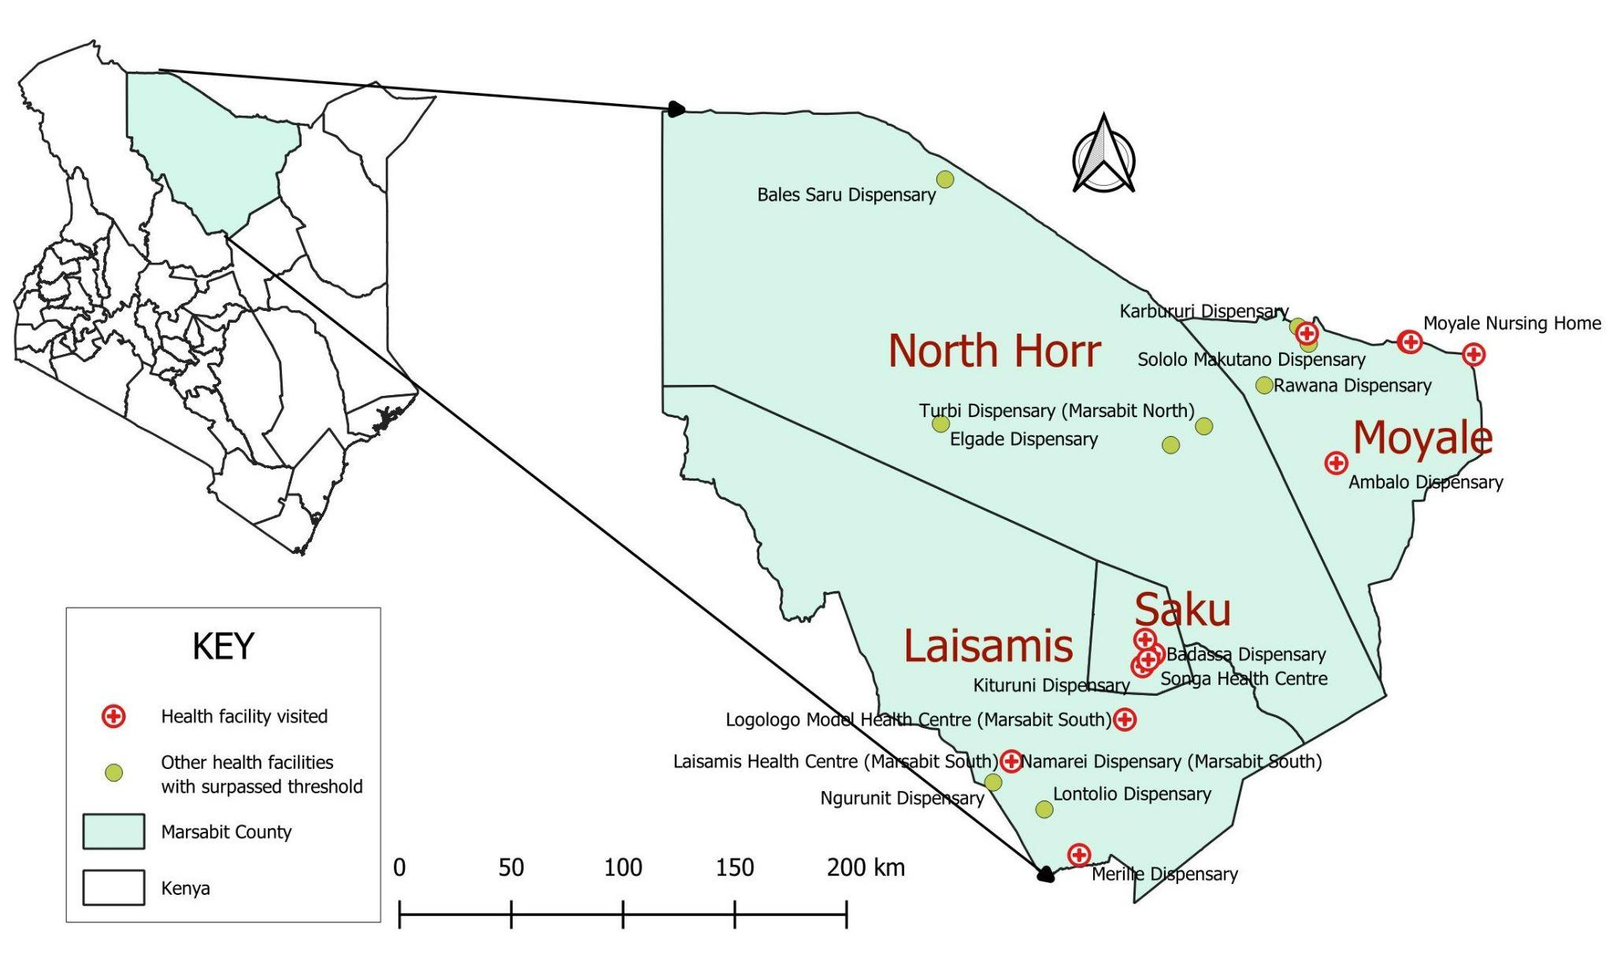
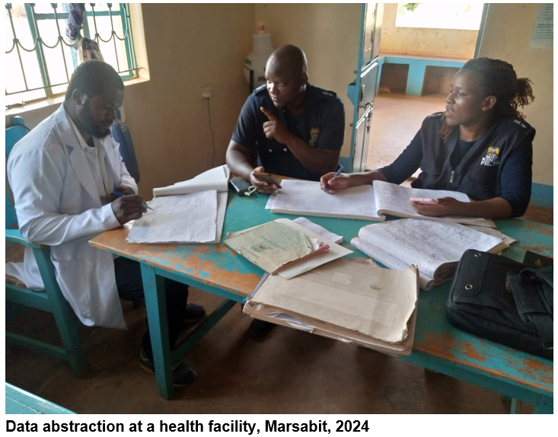
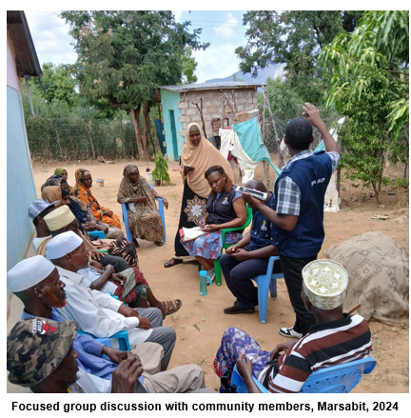
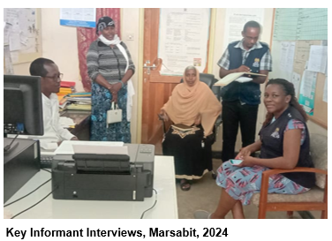
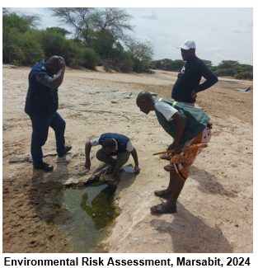





Strengthening Early Warning and Response: Lessons from the 2024 Malaria Outbreak in Marsabit County
Muguku P.W^{1,2} , Fredrick Odhiambo¹ , James Sang² , Emmanuel Sigei¹, Lydia Khalayi¹, Ahmed Abade¹
1: Field Epidemiology and Laboratory Training Program, Kenya. 2: National Malaria Control Program, Kenya
BACKGROUND
Malaria epidemiology in Kenya is heterogeneous due to geographic and climatic differences
Marsabit, a semi-arid seasonal malaria zone inhabited by pastoralists
Increased rainfall in Dec 2023—Jan 2024, with a subsequent increase in malaria cases by 345% (from 210 the previous year to 934)
OBJECTIVE: An outbreak investigation conducted to characterize the confirmed cases and guide prevention and control
METHODOLOGY:
Reviewed routine surveillance data from December 2023 to February 2024; then abstracted data from 12 health facilities with surpassed action thresholds (5-year weekly median + third quantile)
Data quality assessments, key informant interviews (KII), environmental assessment and two community-focused group discussions
STUDY AREA: Marsabit, Kenya
STUDY DESIGN AND SAMPLING
STATISTICAL ANALYSIS:
Frequencies
Proportions (%)
Attack Rate (AR) in cases per 1000 population
Case Fatality Rate (CFR) in %
Figure 1: Map of Kenya showing Marsabit County and Data Abstraction Sites, 2024
RESULTS
DISCUSSION
Supply of RDTs at Songa HC
ITNs distribution at Songa
Majority of cases were due to P. falciparum
Non-falciparum species could have been missed due to widespread use of P.falciparum-specific rapid diagnostic tests
    Incomplete reporting could have delayed the response
    Highest AR was in a relatively new transmission focus
    Pastoralists’ mobility and herding-related overnight stays as potential transmission risk
Increased rainfall
Figure 2: Epicurve of malaria cases in Marsabit County, December 2023–February 2024
CONCLUSIONS
Table 1:Demographic Characteristics of cases, Marsabit, 2024
Table 2:Clinical Characteristics of Cases, Marsabit, 2024
Variable | No. of Cases | Proportion (%)
 | (n =757)
Age
<5 | 96 | 12.7
5-9 | 82 | 10.8
10-40 | 452 | 59.7
>41 | 109 | 16.8
Missing | 18 | 2.4
Sex
Female | 322 | 42.5
Male | 424 | 56.0
Missing | 11 | 1.5
Testing Method
mRDT | 421 | 55.6
Microscopy | 336 | 44.4
Species detected
P. falciparum | 740 | 97.8
P. vivax | 9 | 1.2
P. ovale | 6 | 0.8
P. ovale & P. falciparum¹ | 2 | 0.3
Diagnosis
Uncomplicated Malaria | 662 | 87.5
Severe Malaria | 90 | 11.9
Malaria in pregnancy | 5 | 0.7
Sub County
Moyale | 328 | 43.3
Saku | 273 | 36.1
Laisamis | 156 | 20.6
Malaria Classification | Number of cases (n=757) | Proportion
Malaria in pregnancy | 5 | 0.7%
Severe Malaria | 90 | 11.9%
Suspected malaria | 4 | 0.5%
Uncomplicated Malaria | 658 | 86.9%
Outbreak was predominantly caused by P. falciparum, with the presence of non-falciparum species
Suboptimal surveillance data quality and late response
Need for integrating meteorological early warnings into routine subnational surveillance
Improving surveillance data quality and timely activation of rapid response teams
Strengthening case detection for non-falciparum malaria
Tailoring targeted malaria control interventions for nomadic pastoralists during rainy seasons
>2-fold increase in test positivity; 28.8% (Dec) to 65.7% (Jan)
Songa HC; AR = 80 cases/1000 pop.
Data completeness 39%; Reporting Accuracy 33%
Preoutbreak EPR interventions (SBCC, description of cases and deployment of RRTs were inadequate
Community reported proximity to national park, stagnant water and sleeping outside as potential environmental risk factors
Contact: wachirawash@gmail.com
https://doi.org/10.4269/ajtmh.24-0681
INSERT CO-AUTHOR 4 INSTITUTIONAL LOGO

